Slide 1


AI based Subjective Answer Evaluation
AI Subjective Answer Evaluation
Pragyan Yadav
Pragyan Yadav

Slide 2
Introduction
Subjective Written Assessment plays a significant role in any educational process because it is a common way to evaluate the student’s knowledge regarding the concepts related to learning objectives. Teachers spend lot of time in evaluating answer sheets. If this task can be done by an AI, the teachers can decrease their burden significantly. It will also introduce impartial assessment.

Slide 3
Who is affected by the problem? | Education Institutions
Why is it a problem? | A major part of a teacher’s time is spent in evaluating answer sheets.
Where is the problem? | In educational institutions.
What is the problem? | Teachers spend a lot of time in checking answer sheets of exams. They can also have mistaken and can be biased while evaluating answer sheets.

Slide 4
Key Features
The standard answer(provided by teacher) and the answer given by the student will be compared by deep learning. Marks would be given on the similarities in the answers.
Spelling check will be a part of evaluation.

Slide 5
BERT
Bidirectional
Encoder
Representation
Transformer

Slide 6
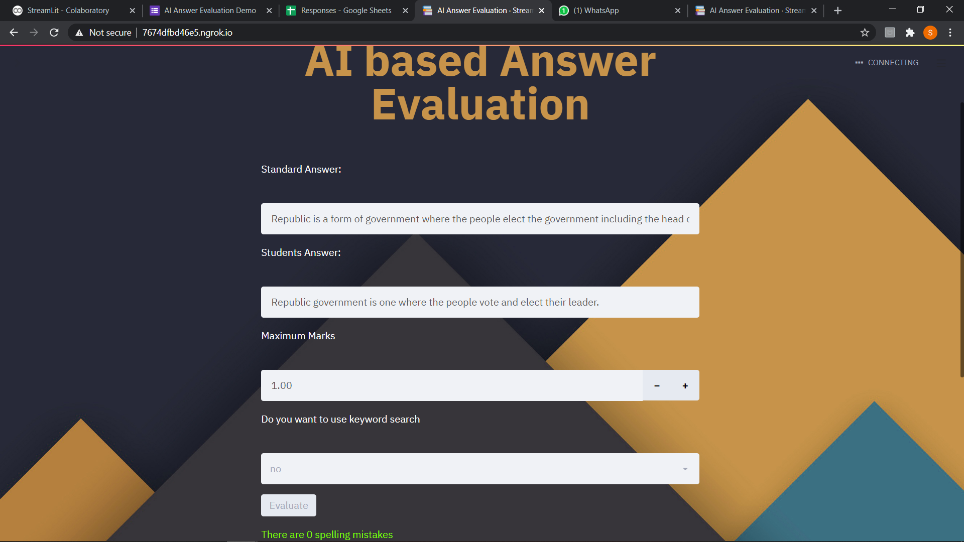

Slide 7
